Slide 1
Market engagement and consultation in the procurement process
Market engagement in practice: Case example from Regional Energy Agency and City of Koprivnica, Croatia
Denis Premec
Regional Energy Agency North, Croatia
26 April 2022

Slide 2
ABOUT US
Regional Energy Agency North
renewable energy sources, energy efficiency, rational use of energy and environmental protection
independent and not-for-profit institution
providing support, consulting and related services to all participants directly or indirectly involved in energy in north Croatia region
Denis Premec
project manager in the field of energy retrofitting projects
responsible for the development and management of all stages of projects – from specifying the procurement of project designing services to contracting works and controlling the final results

Slide 3
IMPORTANT FACTS OF INNOVATION PROCUREMENT PROCESS
The challenge: The kindergarten building – considered to be near the end of its useful lifetime → Remodell rather than Demolish + Energy retrofitting of the kindergarten
The goal – finding an innovative solution to:
avoid the demolition of the kindergarten and construction of a new one (both = substantial cost),
enhance the building and extend its lifetime → get a better learning and play environment
get a replicable solution for same or similar buildings in the city and in the region = a benefit for both procurer and bidder.
Innovative, External and Internal replicable solution for energy efficient and functional transformation of a 35 year old prefabricated wooden kindergarten.
300.000,00 € [VAT excl.]
The innovation resulted from the combination of existing materials and basic techniques not previously offered or used in the market.

Slide 4
THE COURSE AND RESULTS OF THE PROJECT
The tendering procedure started on 31 Jan 2019, the contract signed on 24 Apr 2019
the works started on 10 Jun 2019
the innovative solution delivered on 31 Aug 2019
= 35 days project design + 80 days implementation
Work possible only during summer holidays (toddlers and construction works do not mix well)
Innovative Measure 1 - A complete replacement of all inadequate water supply pipes and installation of new water supply and drainage without extensive invasive works;
water supply system with almost no need for supporting structure, which proved to be both innovative and cost effective solution
Innovative Measure 2 - The thermal protection of building envelope - thicker-than-possible thermal protection of external walls due to innovative reinforcing of the exterior walls construction by using OSB panels;
the sustainable material used for the building envelope reconstruction (wood, OSB panels)

Slide 5
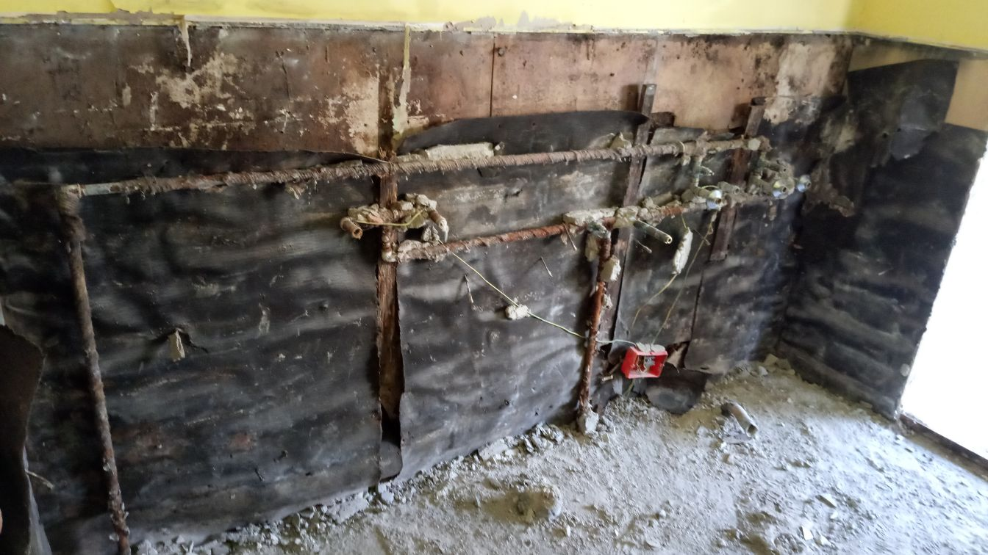
Innovative Measure 1
A complete replacement of all inadequate water supply pipes
with as few invasive works as possible

Slide 6
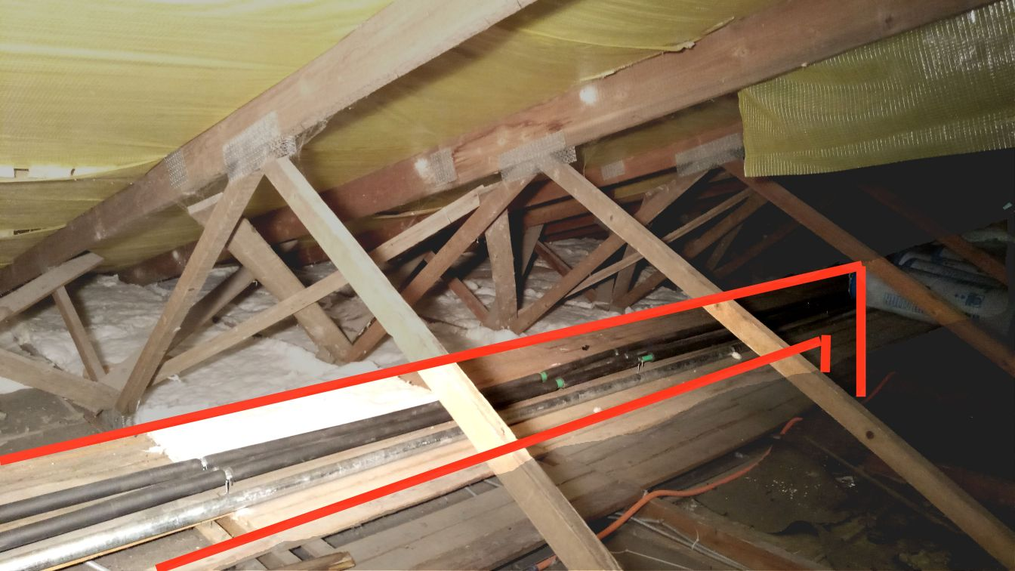

Slide 7
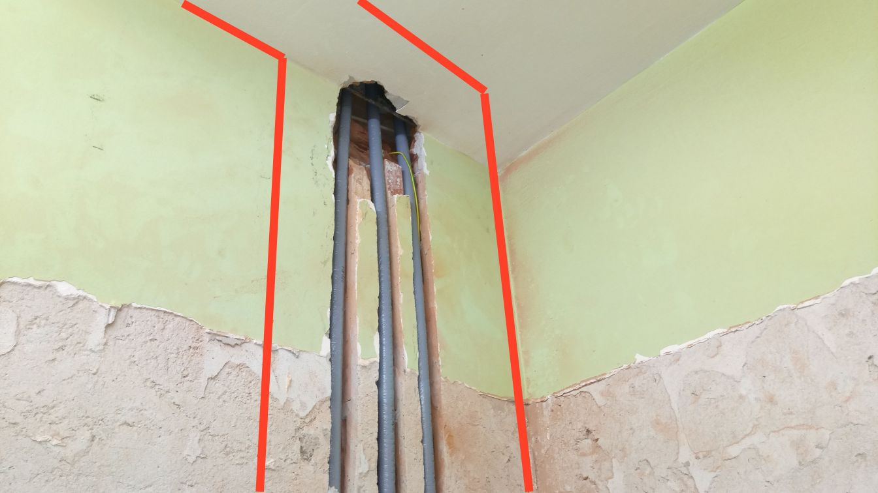

Slide 8
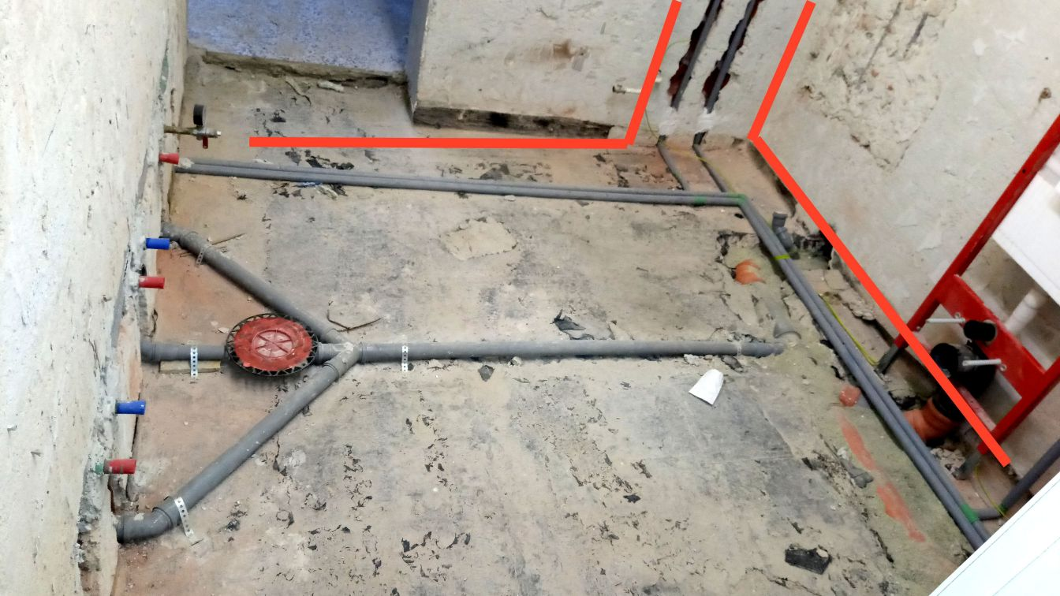

Slide 9
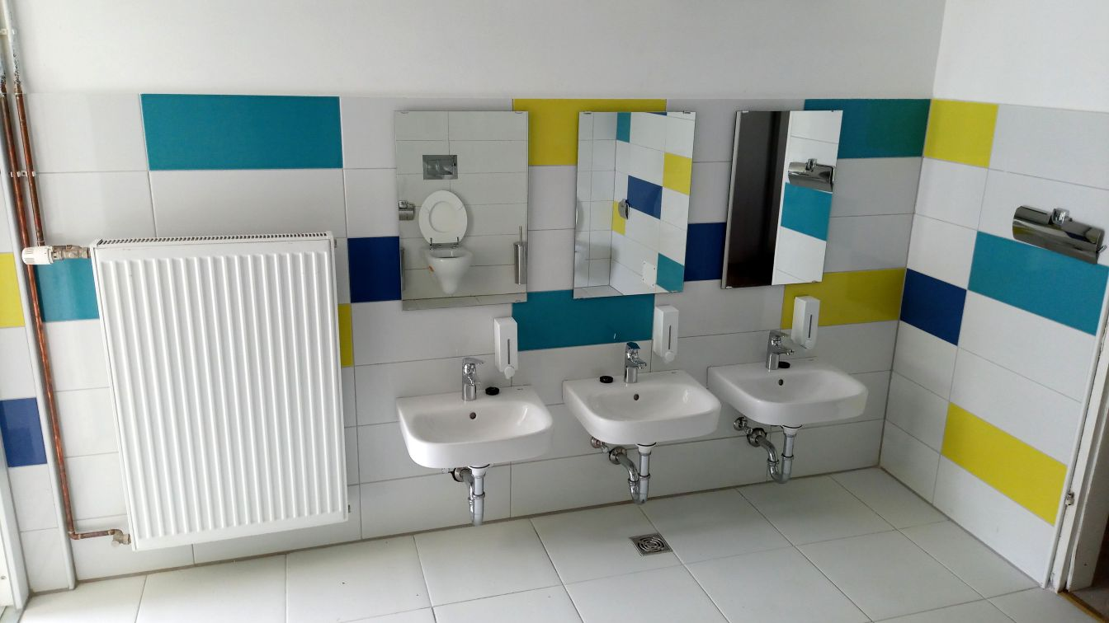

Slide 10
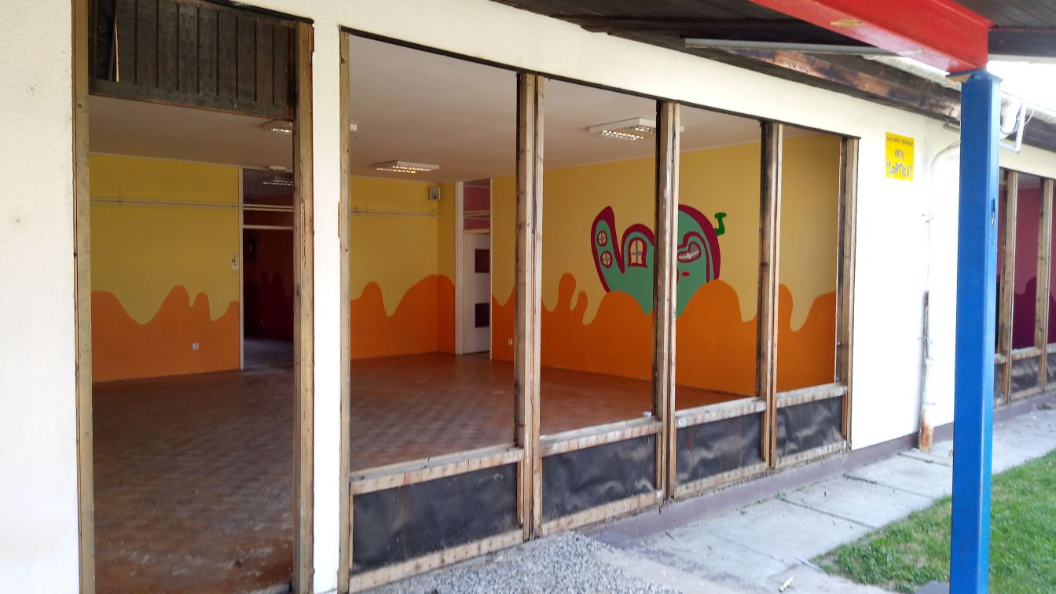
Innovative Measure 2
Reinforcement of exterior walls for thicker-than-possible thermal protection

Slide 11
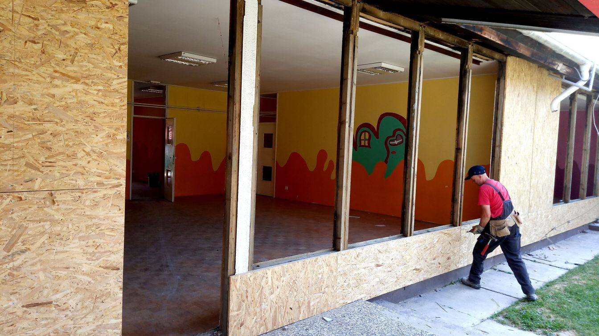

Slide 12
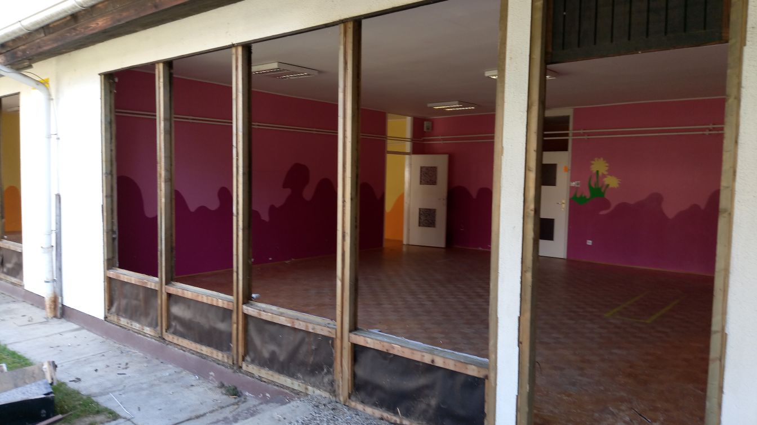

Slide 13
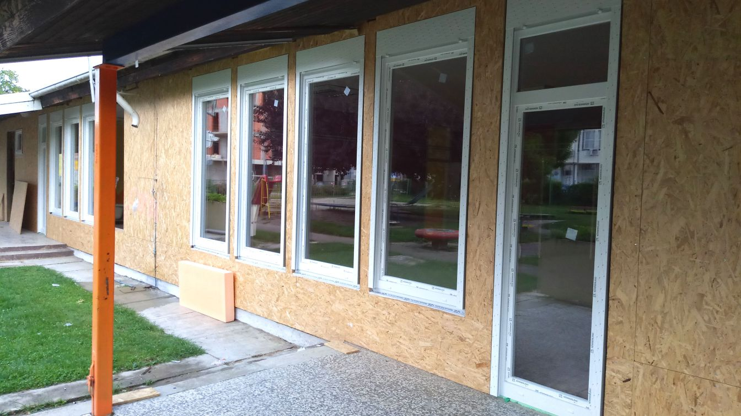

Slide 14
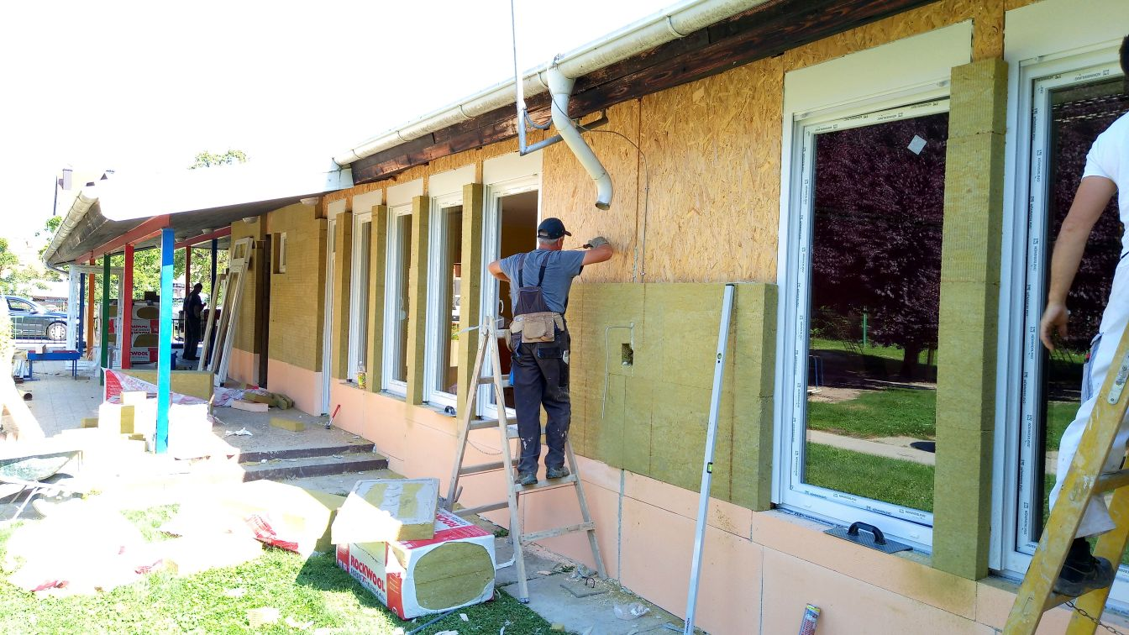

Slide 15
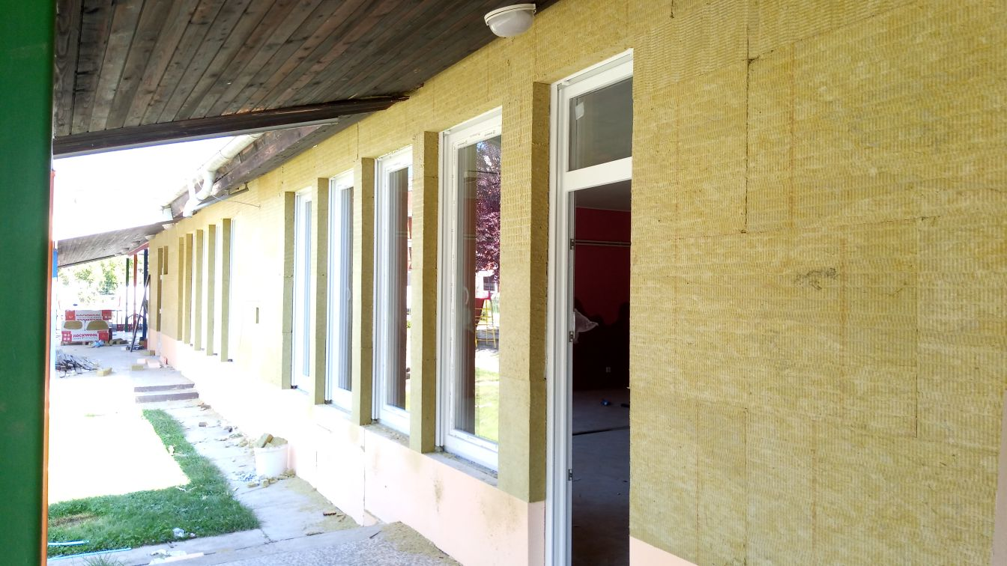

Slide 16
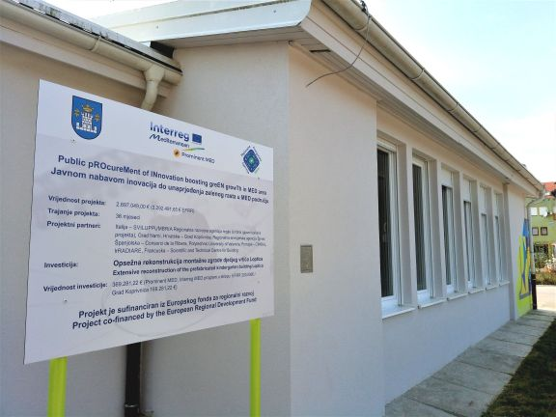

Slide 17
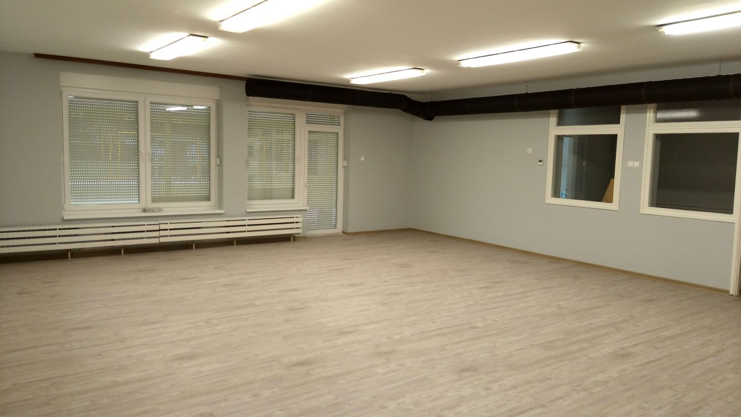

Slide 18
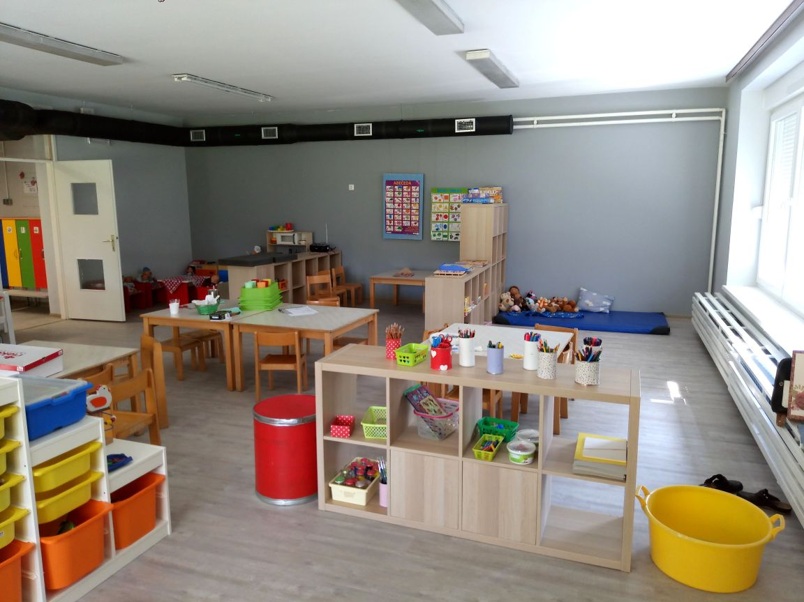

Slide 19
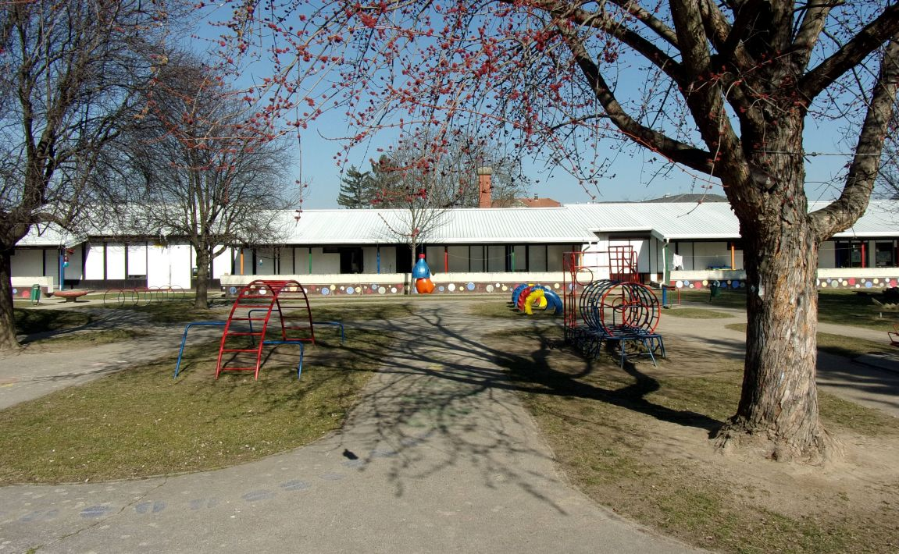

Slide 20
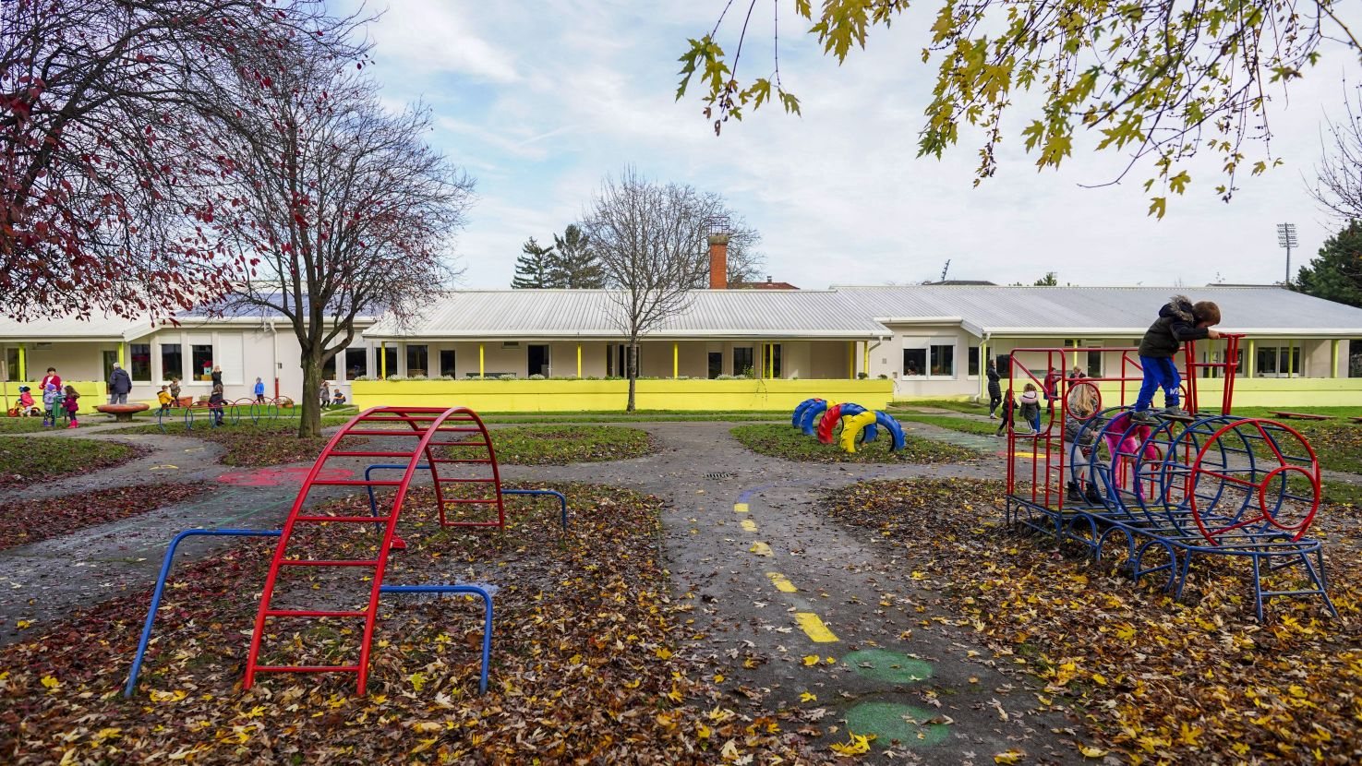

Slide 21
STAKEHOLDERS' IMPORTANCE
Needs identification - the first critical part of the project;
during this phase we discussed with local end-users, which involved two separated focus groups, and with all other local stakeholders (primarily City of Koprivnica, kindergarten owner)
Identified representatives of possible future end-users on a nationwide scale: a market research to identify the possible market size, determine capitalisation possibilities and gained preliminary expressions of interest from 60 public administration + business entities + faculties + ministries for the market engagement procedure
Ministry of Construction detected as a stakeholder!
By engaging Design&Build approach + by defining important part of award criteria to be quality and innovation criteria (50 % of points), we had necessary arguments to encourage bidders to compete with effective, long(er) lasting and innovative solutions
Proving all that feasible, we also engaged extra funding from main stakeholder, City of Koprivnica

Slide 22
PROBLEMS AND RISKS WE HAVE FACED
Changes in the Croatian construction market dramatically impacted the market conditions → The impact came to its peak in the middle of 2018
Reason 1: Drainage of skilled workforce to Germany and other EU countries resulted with limited supply capabilities of Croatian companies
Reason 2: More than 200 million euros from EU funds placed on the market through public calls in 2017 and 2018 (just for public buildings, the overall amount was even bigger)
Consequence 1: The market responded by increasing the prices for more than 30 % on average
Consequence 2: Construction companies overloaded due to extremely increased demand for construction works
We realised that the market appetite for our project, and especially for innovation demand, became limited
Worried if our small project would be interesting in such a changed market

Slide 23
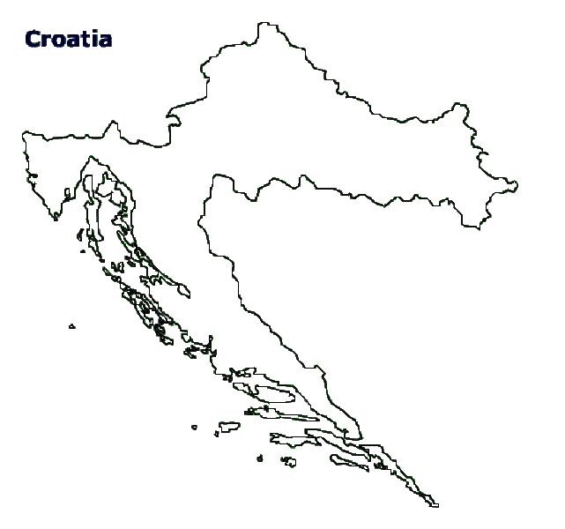
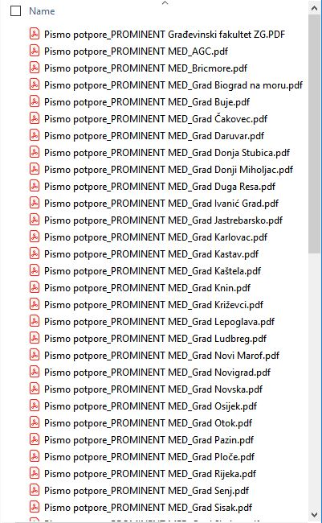
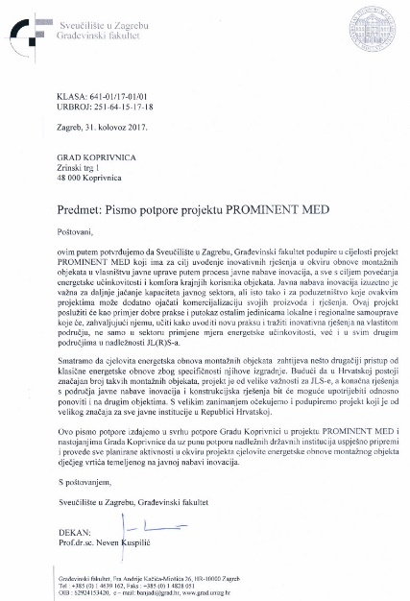
MARKET ANALYSIS & CREDIBILITY
Population
4,0 mil
Analysis of market potential regarding existing prefabricated kindergartens in Croatia → 127 cities all over Croatia analysed
Result: min 25 similar prefab buildings found (dots) → we decided this could be attractive enough to suppliers (replicability)
60+ Letters of interest collected – cities, local authorities, faculty, ministry
Additional funding from City of Koprivnica budget
All building technical documentation published, including Analysis of building construction health
Showing the credibility – wider credible demand – very important for such a small project and for such a difficult (=unexperienced) sellers’ market
Let’s see the tools we used to show credibility → →

Slide 24
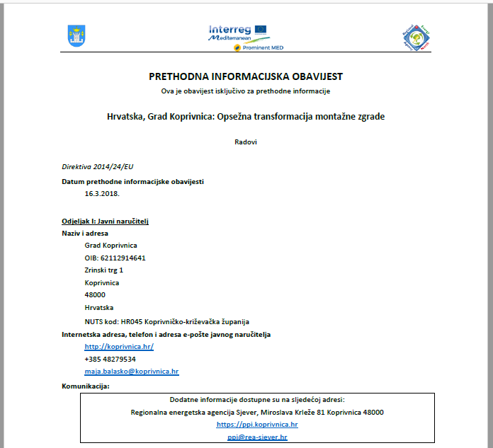
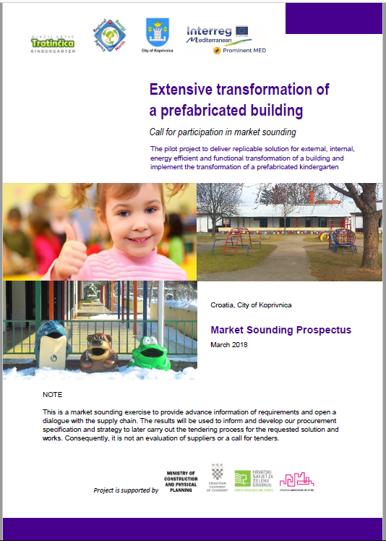
MARKET SOUNDING – TOOLS USED
Prior Information Notice, published in March 2018 in National Official Journal (for the first time ever!) and in EU Official Journal (TED)
Not the tender beginning → basic info and a signal for suppliers that things are getting serious from now on
Simultaneously the Market Sounding Prospectus has been published
Much more important document, containing pilot description, OBR's, further OMC process
Simply publishing PIN is not enough – suplemental and comprehensive market action is needed
Good communication materials and campaign are of great importance for attracting suppliers

Slide 25
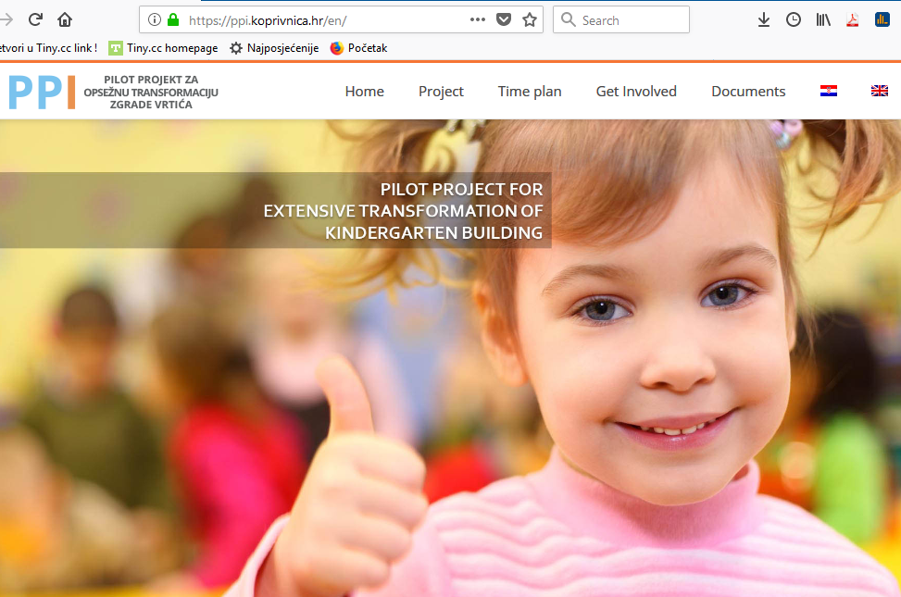
MARKET SOUNDING – TOOLS USED
E-mail campaign launched immediately
15.600 emails sent (prior to GDPR ☺)
Informing about the PIN, MSP and the…
PILOT PROJECT
MARKET SOUNDING WEB PAGE
to show professionalism and
visualise credibility
simple and intuitive design
direct and clear information
in national and ENG language

Slide 26
ppi.koprivnica.hr/en/
Tools offered for supply side:
Complete pilot project technical documentation
Site visit reservations
Market Consultation Workshop registration
Questions and Answers
Suppliers connecting tool
Expressions of interest
Let me walk you through the webpage…

Slide 27
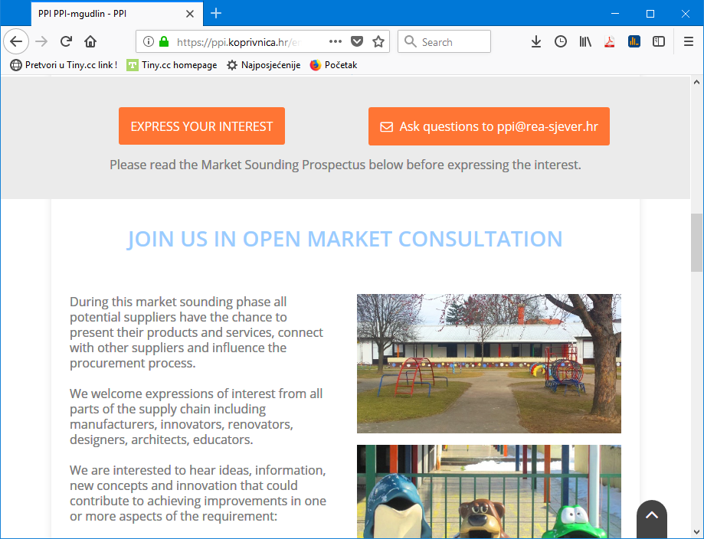

Slide 28
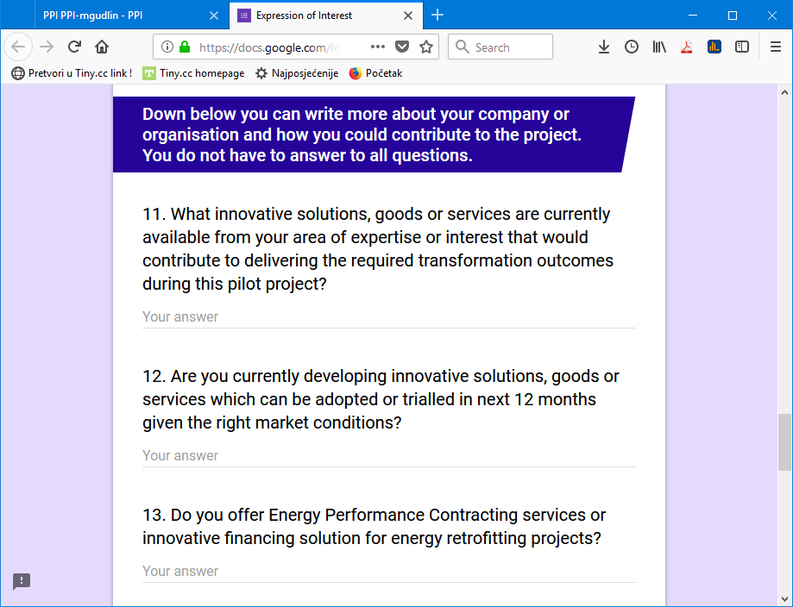
30 expressions filled by interested suppliers
Many received expressions were quite detailed, with a very clear wish to cooperate
3 site visits arranged and conducted
Supply chain feedback, intense communication
Additional proactive seeking and engaging suppliers in a difficult sellers’ market

Slide 29
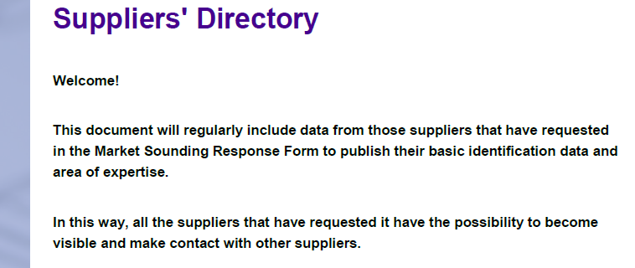
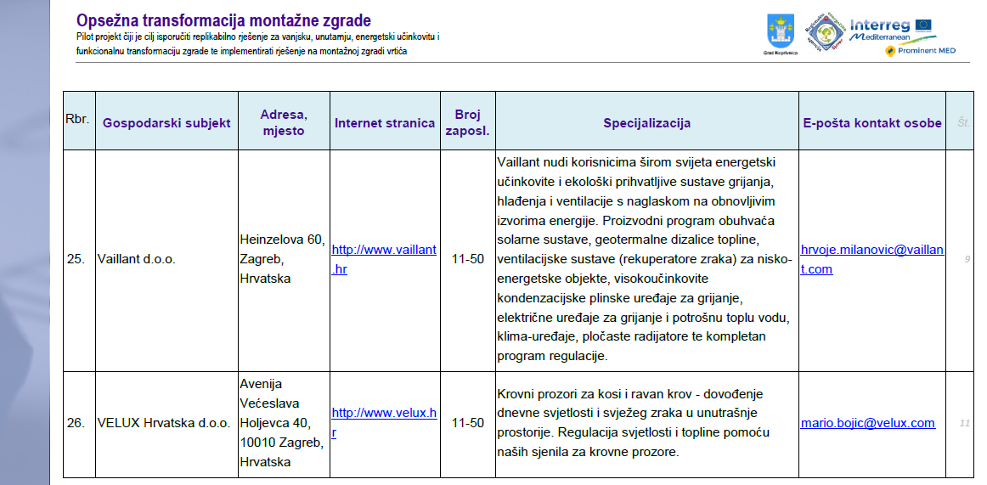
RESPONSE AND SHARING DOCUMENT
26 suppliers shared their contact info and description of their specialization and interest in the procurement
It was an opportunity for them to find compatible suppliers and to eventually later step together into partnership for tendering procedure

Slide 30
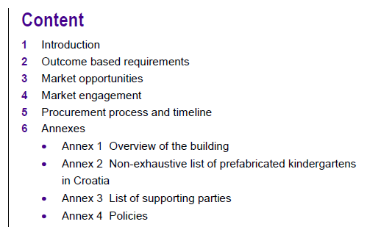
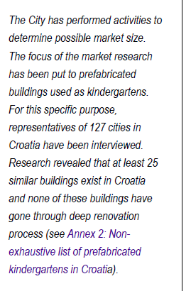
WHAT'S IMPORTANT FOR MARKET SOUNDING PROSPECTUS
You probably won't be able to write an MSP on your own. Use consultant! (thank you, Gaynor!)
Structure & Design + Be clear and concise
Clearly state that it's not the start of tendering process (motivates supply side to involve)
Not a technical document, watch the language
Show credibility by showing how good you know the case and what are market opportunities based on your careful research
Show your stakeholders and supporters!
Quote someone or highlight something
Show what you expect from supply side

Slide 31
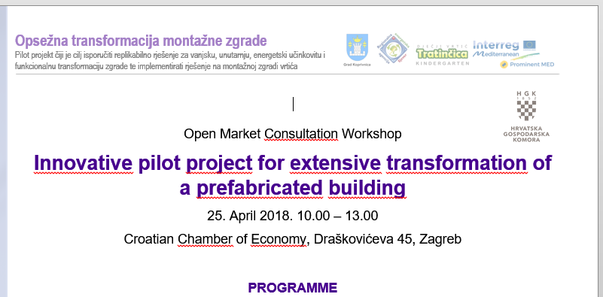
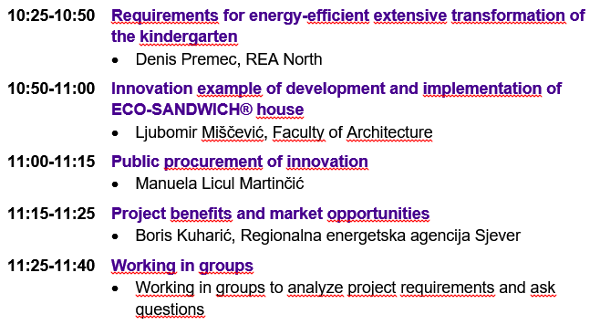
OPEN MARKET CONSULTATION WORKSHOP

Slide 32
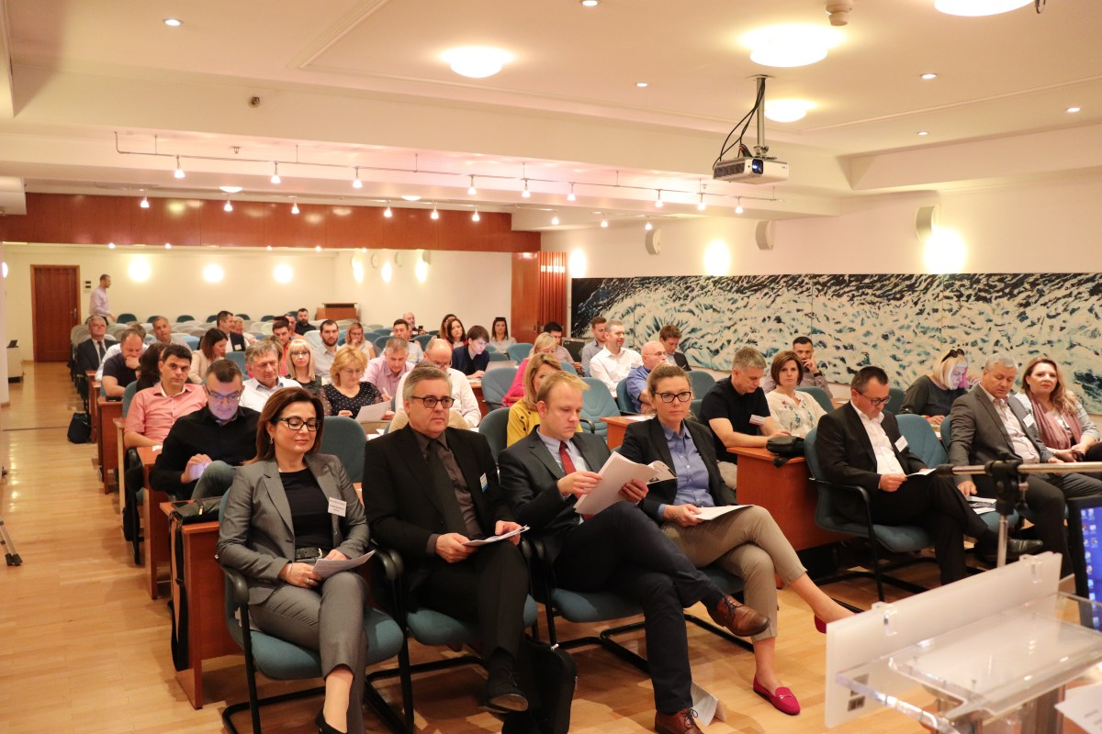
OPEN MARKET CONSULTATION WORKSHOP
Based on workshop feedback we were finally able to start preparing the procurement procedure

Slide 33
FINAL IMPACTS OF INNOVATION PROCUREMENT PROCESS
Improved building with extended lifetime of 25+ more years
For the cost of less than 500,00 € per square meter, approx. 50 % cost of a new building
61 % savings on heating energy, 66 % savings on primary energy and 66 % less CO2 emissions, all per year
We have diverted from landfill the whole building with net area of 820 m2
Enhanced the learning and play environment for children, including safety and comfort
The flexibility of possible innovative solutions (flexible output-based requirements) stimulated the supplier to develop simple, but effective innovative solutions
The supplier upgraded its knowledge in public procurement, is now more confident and motivated to participate in similar demanding tenders
An opportunity for supplier (and client) to perfect the work in Design & Build

Slide 34
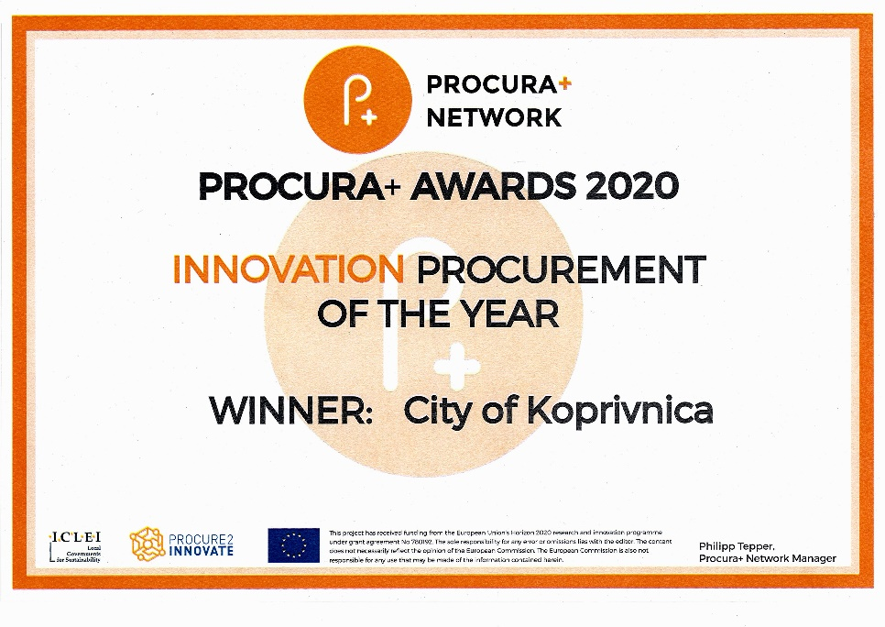
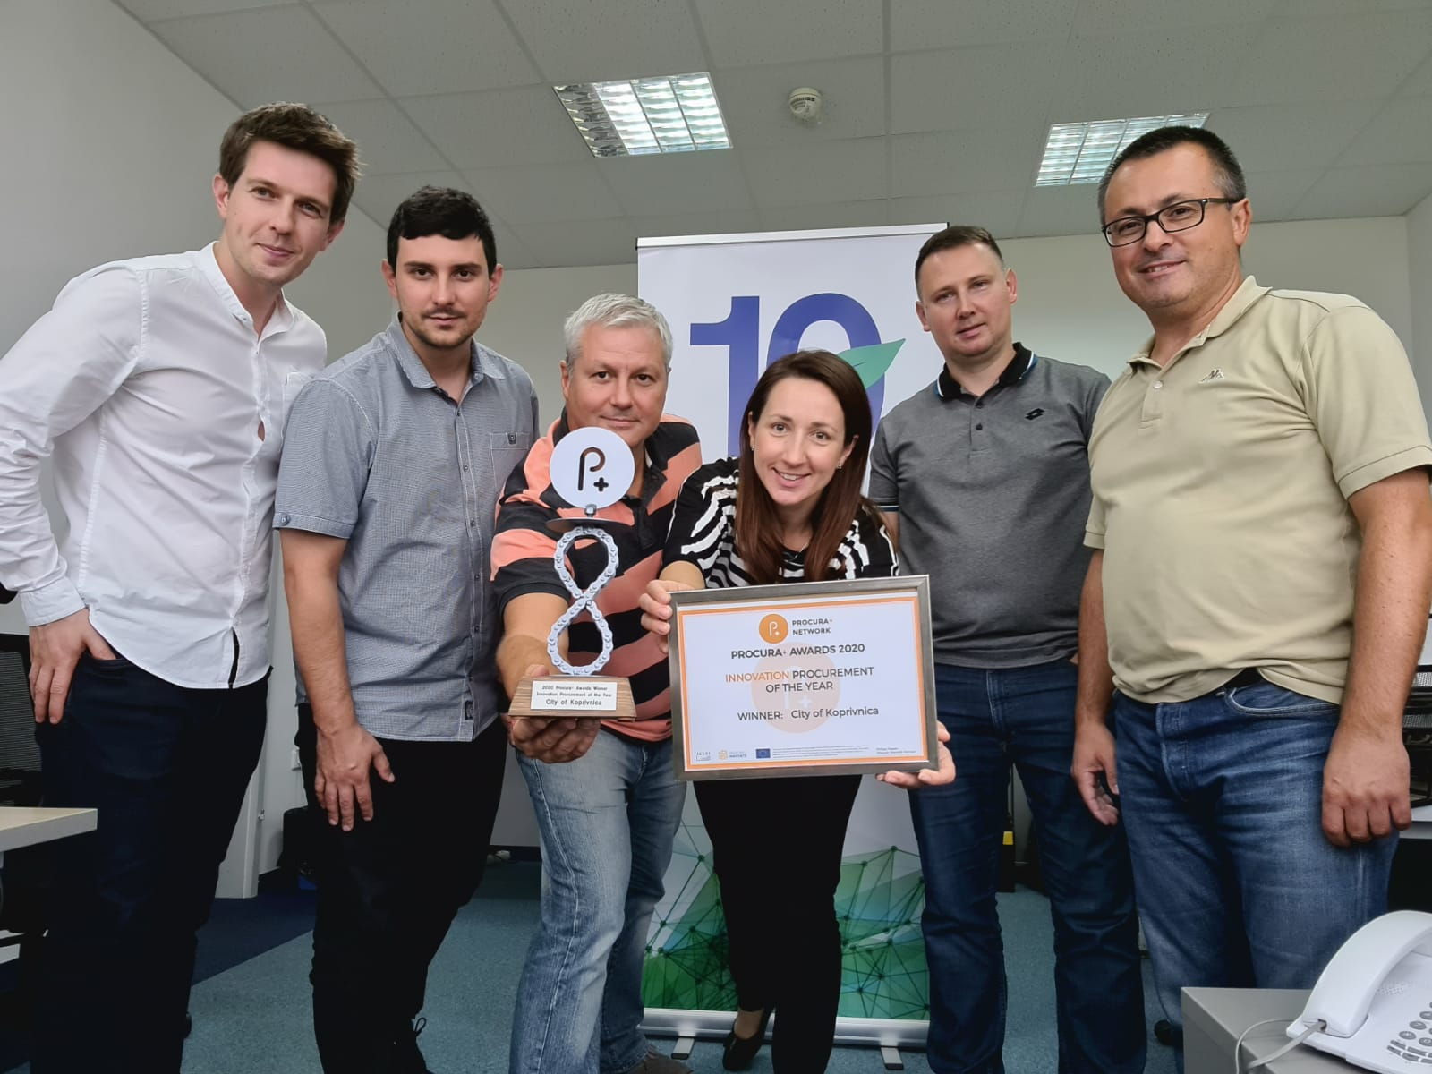
RECOGNITIONS
Innovation procurement for extensive transformation of an old prefabricated kindergarten building
As a part of Prominent MED, Interreg MED, with City of Koprivnica
A lot of effort, but paid off. Among other also by…
Green building council award RECONSTRUCTION OF THE YEAR 2019
Procura+ Award INNOVATION PROCUREMENT OF THE YEAR 2020

Slide 35
THANK YOU FOR YOUR CONCENTRATION!
Denis Premec
REA North
Prominent MED / Prominent PLUS
denis.premec@rea-sjever.hr
https://www.rea-sjever.hr

